Slide 1
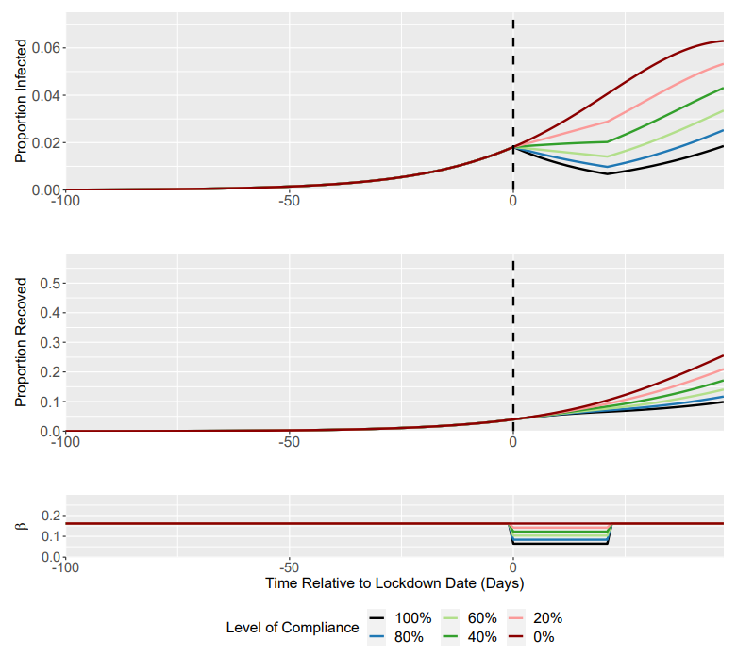
Compliance Level | R0 under Lockdown (Baseline = 1.5) | I(t) at Lockdown Trigger | I(t) at 3 weeks post-Lockdown | Time to Return to Pre-lockdown I(t)
100 | 0.6 | 0.0182 | 0.007 | 26
80 | 0.78 | 0.0182 | 0.010 | 17
60 | 0.96 | 0.0182 | 0.014 | 7
40 | 1.14 | 0.0182 | 0.020 | N/A
20 | 1.32 | 0.0182 | 0.029 | N/A
0 | 1.5 | 0.0182 | 0.041 | N/A
For a lockdown compliance of 100% (R0 = 0.6), I(t) returns to pre-lockdown levels (0.0182) ~26 days after the initiation of 3 week lockdown.

